Slide 1
Target output words
I
am
a
student
</s>
Loss layer
Projection layer
Hidden layer1
Hidden layer2
Embedding layer
I
am
an
student
<s>
I
am
a
student
Source input words
Target input words

Slide 2

















$$y$$
$$y_{t−1}$$
$$y_{t}$$
$$y_{t+1}$$
$$W$$
$$W$$
$$W$$
$$W$$
$$W$$
$$h$$
$$h_{t−1}$$
$$h_{t}$$
$$h_{t+1}$$
unfold
$$x$$
$$x_{t−1}$$
$$x_{t}$$
$$x_{t+1}$$

Slide 3
OUTPUT
ENCODER
DECODER
STATE
INPUT

Slide 4






$$h_{1}$$
$$h_{2}$$
$$h_{3}$$
RNN
RNN
RNN
ENCODER VECTOR
$$x_{1}$$
$$x_{2}$$
$$x_{3}$$

Slide 5
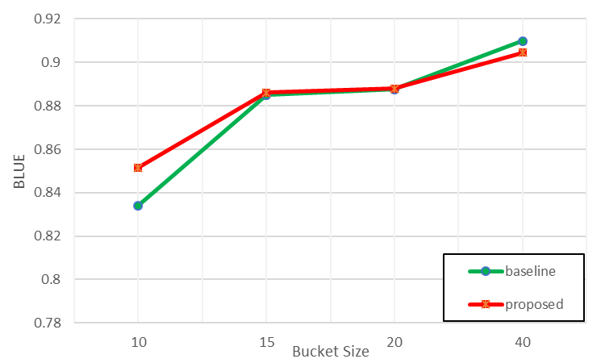
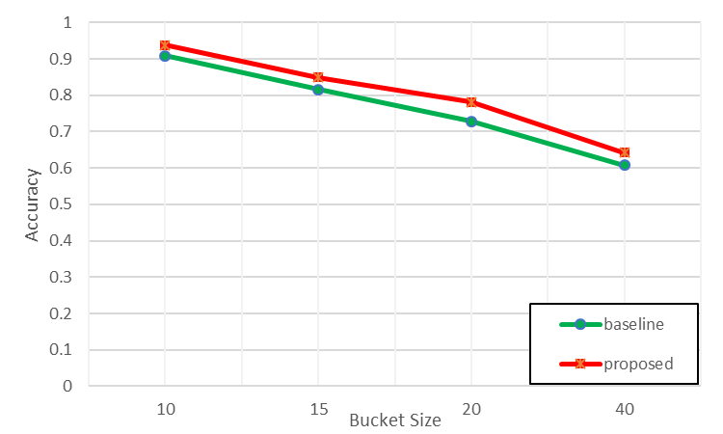


$$y_{1}$$
$$y_{2}$$
ENCODER VECTOR
RNN
RNN

Slide 6
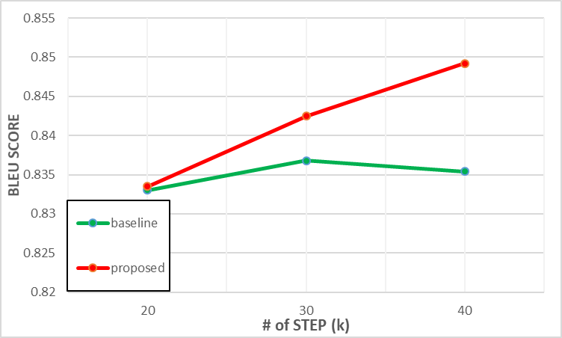
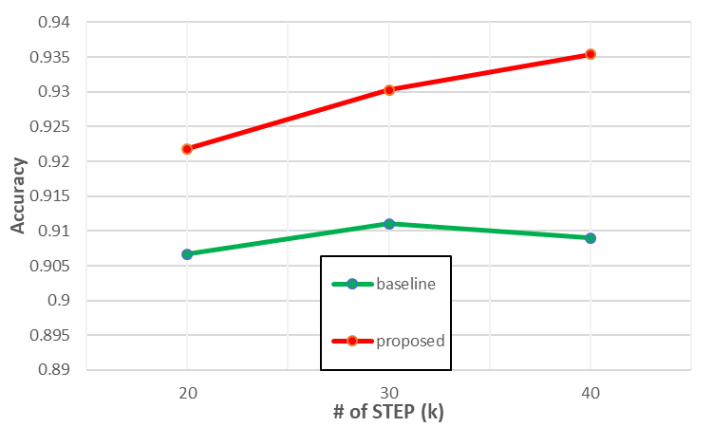
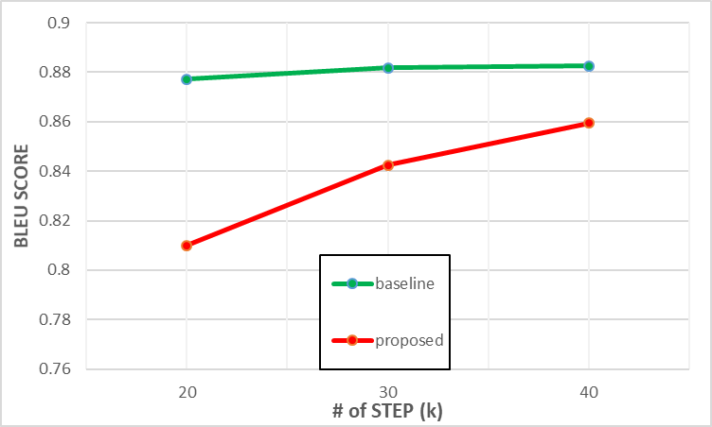
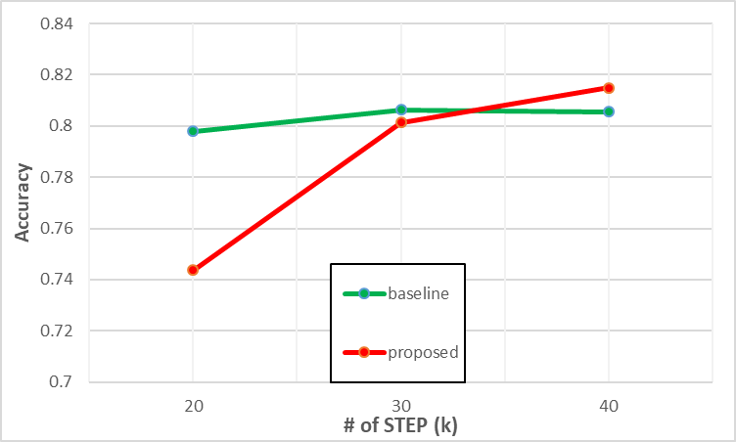
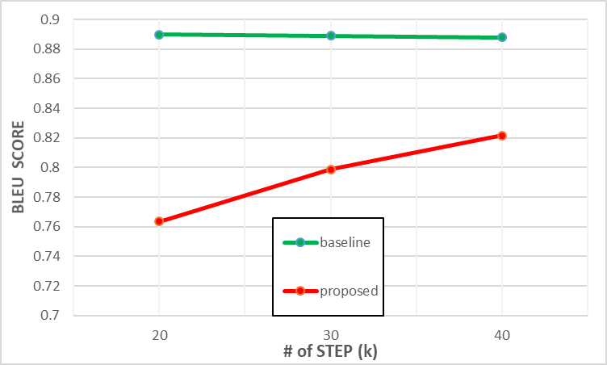
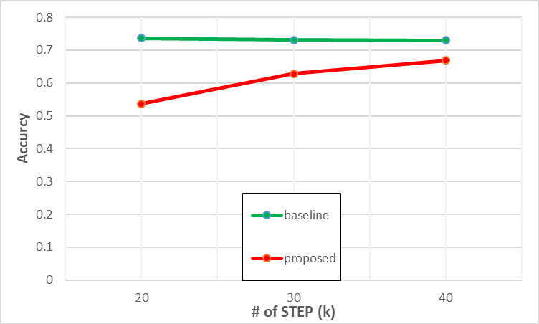

Slide 7
